Slide 1

Stat 464 Final An Analysis of Global Temperature Changes Over Time
An extensive report by Nicholas Way

Slide 2


Abstract
Comprehensive analysis of global temperature trends using climate indicators
Focus on median annual temperature change to identify patterns
Tests for significant monotonic trends as evidence of global warming
Utilizes Page's non-parametric test for ordered data
Results aim to inform climate policy and international strategies

Slide 3


Introduction
Central Issue of Environmental Science
Evolution from Curiosity to Critical Global Challenge
Impacts on:
Natural Ecosystems & Biodiversity
Human Society: Agriculture, Health, Economics
Journey into Temperature Analysis and Global Transformation
Characterizing 'Global Warming':
Rise in Earth's Average Surface Temperature
Interplay of Natural Phenomena and Human Activity

Slide 4
Introduction Cont.
Global climate change, characterized by global warming, has become a pivotal concern in environmental science. This data analyzes temperature changes across various countries to detect patterns that may affirm the global warming phenomenon. The measurements have been updated yearly till 2022 from 1961.
Using a comprehensive dataset of climate change indicators, this report examines the median temperature changes over time and tests for the presence of a significant monotonic trend across years.

Slide 5


Data Source
Repository: Kaggle
Dataset: Climate Change Indicators
Coverage: Years 1961 to 2022
Key Variable: Median Temperature Change
Utilization: Analysis of Global Temperature Trends

Slide 6

Hypothesis
Null Hypothesis (H0): There is no increasing or decreasing trend across the treatments (years).
Alternative Hypothesis (H1): There is an increasing trend across the treatments (years).
The Page's test will evaluate whether the observed data significantly support H1 over H0, under the assumption that the treatments (years) are ordered.

Slide 7

Why Page’s Test?
Non-Parametric: No need for data to follow a normal distribution
Robust Against Irregularities: Handles the complexities of global climate data
Monotonic Trend Detection: Identifies consistent upward or downward temperature trends
Appropriate for Ordered Data: Ideal for analyzing time-sequenced data from 1961-2022
Alignment with Study Goals: Tests for significant trends indicative of global warming
Chronological Analysis: Systematically evaluates yearly temperature changes across nations

Slide 8

Methodology
Data Preprocessing: From wide to long format
Focus: Yearly median temperature change analysis
Tools: R language, ggplot2, tidyverse, DescTools
Statistical Testing: Page test for trend detection
Analysis Span: 1961 to 2022

Slide 9

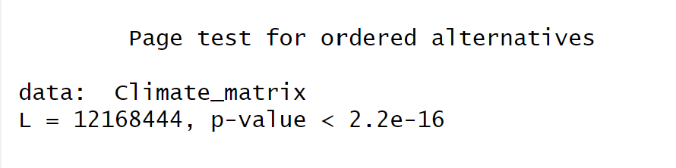
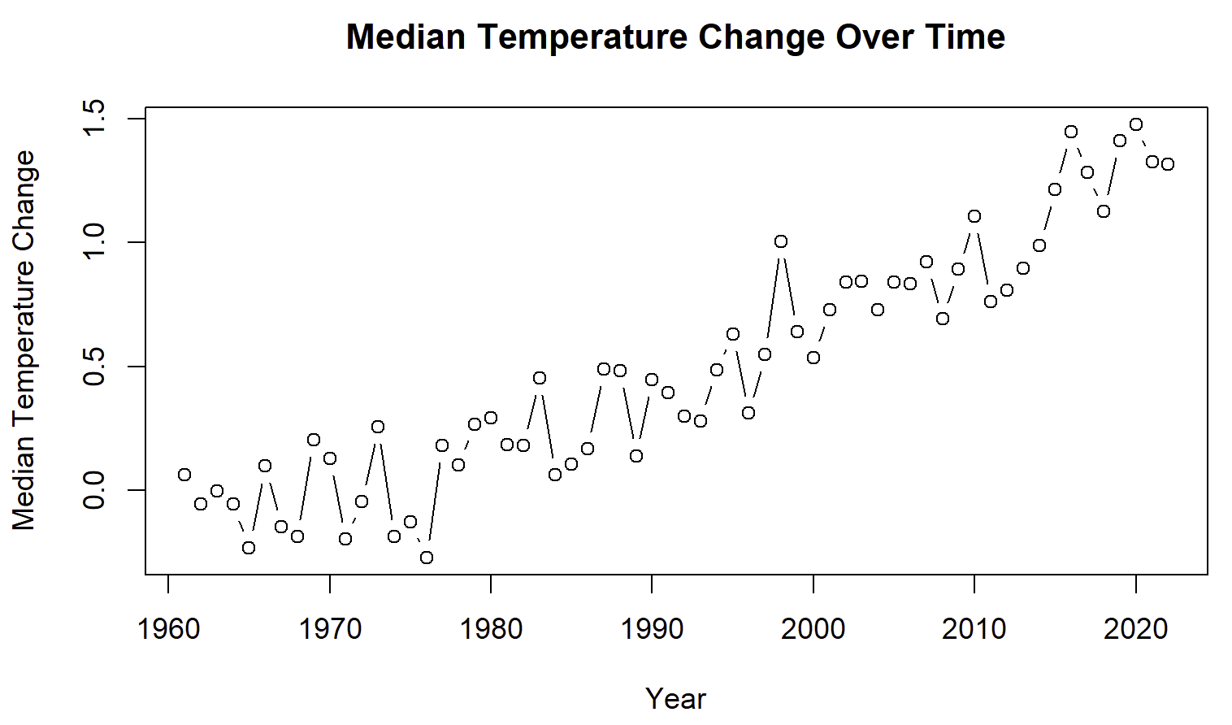
Results
The Page test revealed a p value of < 2.2e-16, indicating a significant monotonic trend in temperature changes over the years examined.
This result supports the alternative hypothesis of a noticeable trend in global temperatures, aligning with the concerns of global warming.
Furthermore, the plot of median temperature changes over time visually corroborates the statistical findings, illustrating a steady increase in global median temperature over the years.

Slide 10


Conclusion
The analysis conducted provides evidence supporting the hypothesis of a significant trend in global temperature changes over time.
This trend is indicative of global warming, highlighting the need for continued monitoring and intervention to mitigate climate change impacts.
Future research should expand on this study by incorporating more comprehensive data and exploring the effects of specific variables such as greenhouse gas emissions and deforestation on global temperatures.

Slide 11


References
Kaggle Data Source: https://www.kaggle.com/datasets/tarunrm09/climate-change-indicators

